Slide 1
British Airway Review Analysis

Slide 2
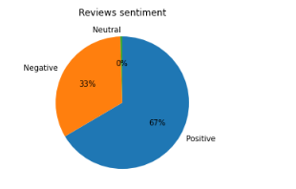
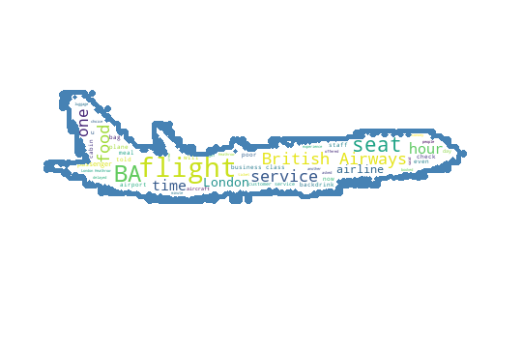
Sentiment Analysis
- The pie chart shows that majority of the reviews are positive statement. While 33% of the statements are negative statements.
The wordcloud shows that majority of the words used in the negative statements are: Flight, Service, Time, Food, Seat, Hour etc. Showing that majority of customers with negative statements we mostly talking about their flight schedule and their service.
Negative statements WordCloud

